Slide 1
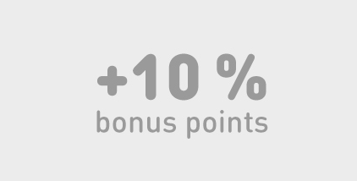
Become a nordic choice club member
Nordic Choice Hotels, with 180 hotels in Scandinavia, has been selected as your supplier of hotel services. Become a Nordic Choice Club member and receive bonus points and benefits at all hotels within Nordic Choice Hotels. Apply now and receive an upgrade to SILVER level! The bonus points you earn can be used as free overnight stays at all Nordic Choice hotels in the Nordic and Baltic countries as well as on selected Choice hotels in Europe.
Apply for Nordic Choice Club SILVER card on our website:
Go HERE and go to if you’re already a member
Go to MY PAGE and find: ADD AGREEMENT
Fill in your company agreement code: 60369423
Click
Go HERE if you’re NOT already a member
Fill in your personal info
Fill in the company agreement code: 60369423
Verify, agree to the membership terms and save the information.
You will receive an email with a link to make your own password.
We no longer issue plastic cards, but will keep in touch by mail
Welcome as a Nordic Choice Club SILVER member!*
You get 5 % on best available room rate.
10 % extra bonus points when booking on www.choice.no.
Free cancellation of booking until 9.00 pm on bookings made through Nordic Choice Hotels. Not applicable on advance payments.
10 % extra bonus points per stay as SILVER member.
Restaurant voucher valued at SEK 75 when you are staying at Clarion Hotel ®, Quality Hotel ™, or any of our independent hotels in Sweden. - You receive one voucher per night. The voucher is only valid the same day.
Possibility of late check out free of charge until 4.00 pm.
Status matching of your SILVER-membership to Hertz Gold Plus Reward - Five Star.
Plus, you get access to all the benefits included in the BLUE membership.
To keep your SILVER level after one year you need at least 5 overnight stays at Nordic Choice Hotels within a
12 month period. Read our membership terms and conditions
Notes:
REMEMBER TO CONVERT TO PDF FOR THE LINKS TO WORK

